Slide 1
SENG 371 Project 2
MEASURING USER SATISFACTION OF GITHUB REPOS
JIAN GUAN, JONATHAN LAM, PAUL MOON

Slide 2
Project Goal
Project Question
How are different types of GitHub activities, such as number of pull requests and number of issues over time, correlated with user satisfaction?
Hypotheses
User satisfaction leads to number of GitHub issues
Number of GitHub pull requests leads to user satisfaction
Notes:
As user satisfaction increases, the number of issues will increase because high user satisfaction will promote discussion and recommendations, which will increase the number of users and therefore the number of bugs & issues.
The number of pull requests will be correlated with user satisfaction. The pull requests will introduce new features, refactor the codebase, and fix bugs, which will increase user satisfaction.

Slide 3
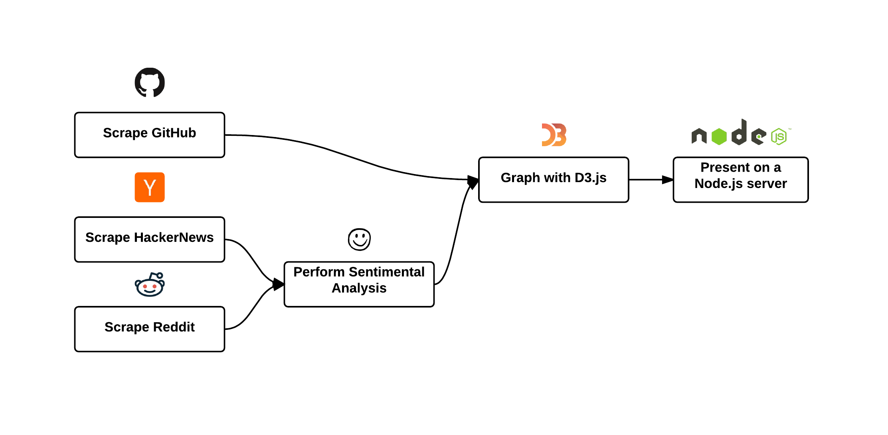
Project Plan

Slide 4
Current Progress
Milestone 1 - March 10, 2015
Prepare a detailed project plan.
Milestone 2 - March 17, 2015
Implement a tool to pull all GitHub activities over time, for any repo.
Implement a tool to query Reddit and HackerNews and collect text containing repo name.
Milestone 3 - March 24, 2015
Write code to run sentimental analysis on any given text.
Write D3.js code to graph the results.
Milestone 4 - March 30, 2015
Polish the tools
Thoroughly analyze the three repositories from the generated graphs
Finish project report
Notes:
LaunchPad Hackathon this weekend
Other schoolwork (Projects, essays)

Slide 5
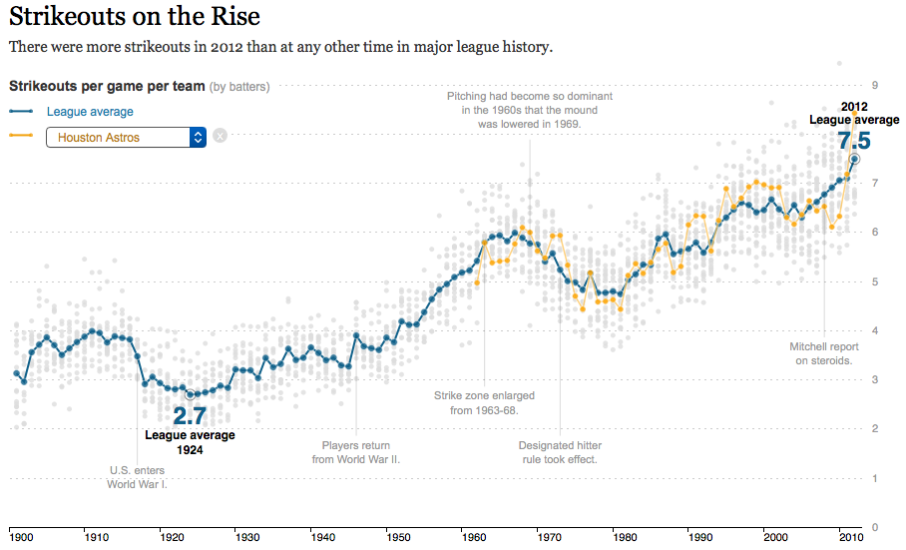
D3.js Inspiration
Source: http://www.nytimes.com/interactive/2013/03/29/sports/baseball/Strikeouts-Are-Still-Soaring.html

Slide 6
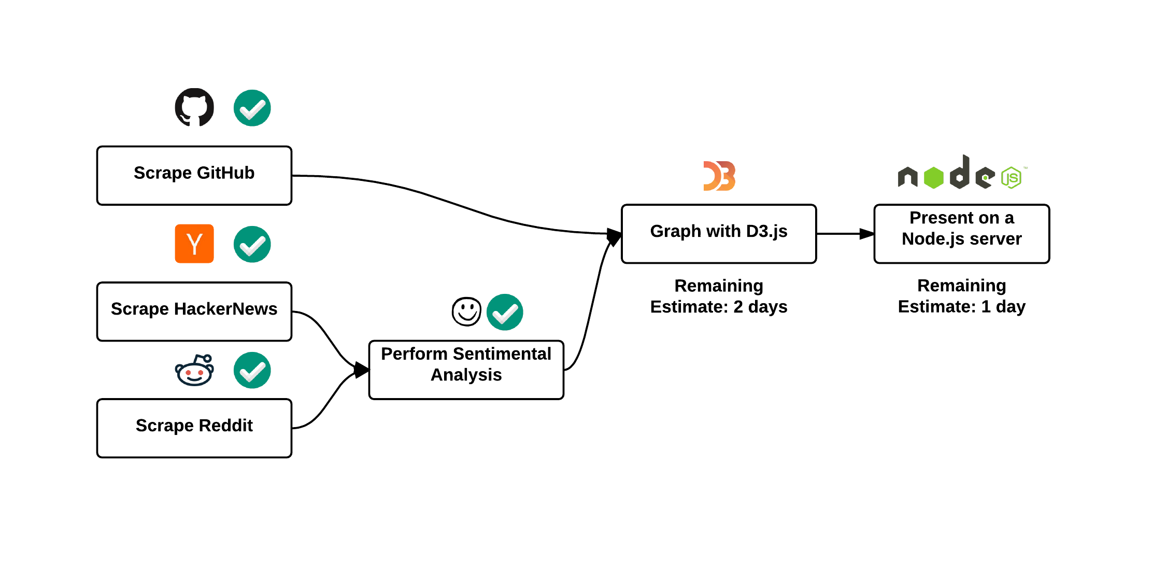
Estimated Remaining Time

Slide 7
Questions?

